Slide 1
Pointers and Structure

Slide 2
CONTENTS
1. Introduction
How memory is allocated for a structure
2. Structure deallocation isues
3. Avoiding malloc/free overhead

Slide 3
Pointers and Structure
Structures in C can represent data structure elements, such as the nodes of a linked list or tree
Understanding the versatility supported by pointers for common data structures will facilitate your ability
to create your own data structures
In this chapter, we will explore the fundamentals of structure memory allocation in C and the
implementation of several common data structures

Slide 4
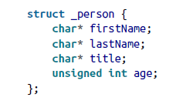
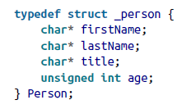
Introduction
Two ways to declare a structure in C
Using the struct keyword
Using type definition
(Using typedef keyword)
Prefixed with an under-score
(not necessary but is often used
as a naming convention)
→ To simplify its use later in a program

Slide 5


Introduction
Ways to declare an instance of a person
or

Slide 6



Introduction
Using the dot notation to access its field
Using a pointer to a structure, we need to use the points-to operator
We can dereference the pointer first and then apply the dot operator

Slide 7
How Memory Is Allocated for a Structure
When a structure is allocated memory, the amount allocated to the structure is at minimum
the size of its individual fields
However, the size is often larger than this sum because of padding
Several implications are related to this allocation of extra memory
Pointer arithmetic must be used with care
Arrays of structures may have extra memory between their elements

Slide 8
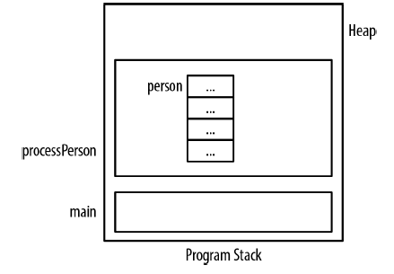
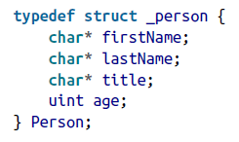
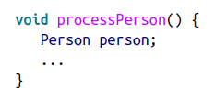
Structure Deallocation Issues
When memory is allocated for a structure, the runtime system will not automatically allocate
memory for any pointers defined within it
Likewise, when the structure goes away, the runtime system will not automatically deallocate
memory assigned to the structure’s pointers
contain garbage
Uninitialized memory

Slide 9
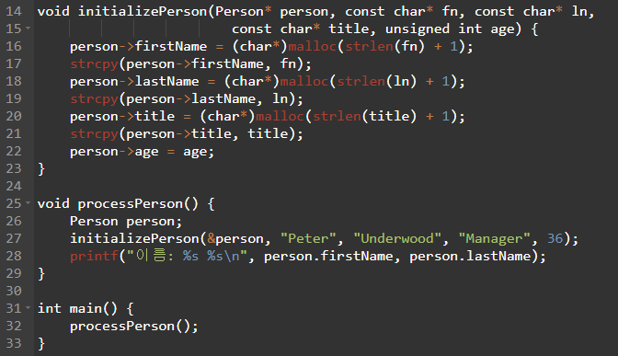
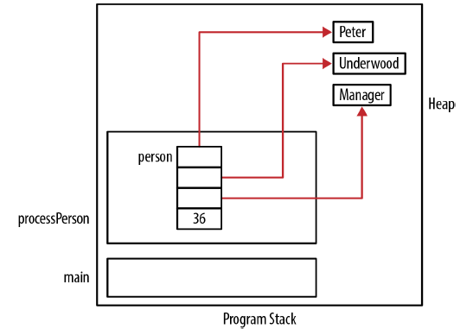
Structure Deallocation Issues
During the initialization of this structure, each field will be assigned a value
The pointer fields will be allocated from the heap and assigned to each pointer

Slide 10
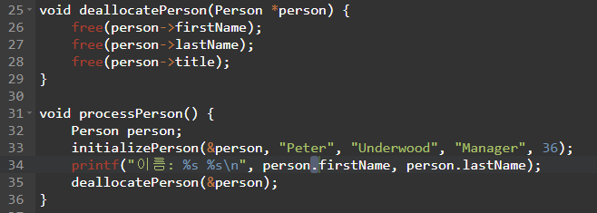
Structure Deallocation Issues
The dynamically allocated strings were not released and are still in the heap
We need to deallocate the memory
Remember to call the initialize and deallocate functions
The automatic invocation of these operations against an object is performed in object-oriented
programming languages such as C++

Slide 11
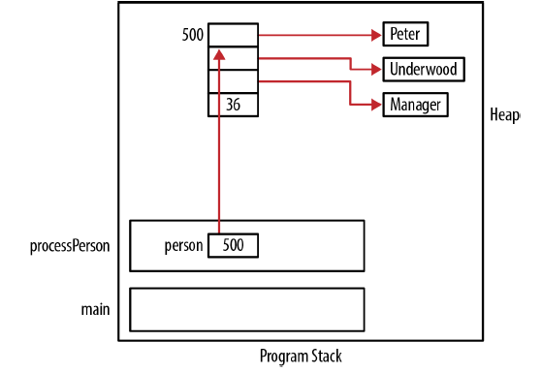
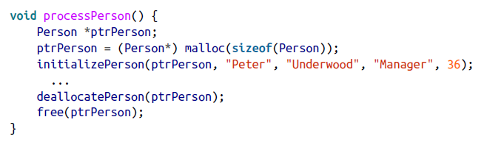
Structure Deallocation Issues
If we use a pointer to a Person, we need to remember to free up the person

Slide 12
Avoiding malloc/free Overhead
When structures are allocated and then deallocated repeatedly, some overhead will be incurred,
resulting in a potentially significant performance penalty
→ Using own list of allocated structure
When a user no longer needs an instance of a structure, it is returned to the pool
When an instance is needed, it obtains the object from the pool
If there are no elements available in the pool, a new instance is dynamically allocated
This approach effectively maintains a pool of structures that can be used and reused as needed

Slide 13

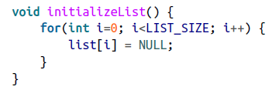
Avoiding malloc/free Overhead
- An array of pointers is used
- It needs to be initialized

Slide 14
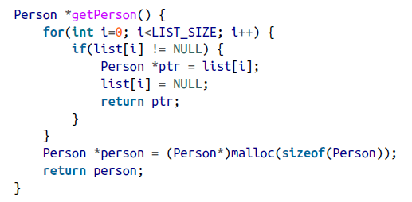
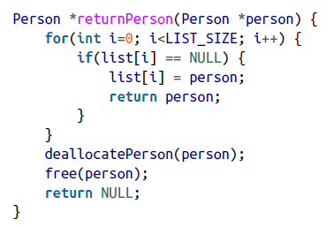
Avoiding malloc/free Overhead
Two functions are used to add and retrieve persons

Slide 15
Avoiding malloc/free Overhead
Problem
If the list is too small, then more dynamic allocation and deallocation of memory will be necessary
If the list is large and the structures are not being used, a potentially large amount of memory
may tied up and unavailable for other uses

